Slide 1

GOEL INSTITUTE OF TECHNOLOGY AND
MANAGEMENT
DEPARTMENT OF COMPUTER SCIENCE AND ENGINEERING
Submitted by
Satyam Sahu
Mohd Kaish Shekh
Indresh Yadav
Submitted to
Mr. Deepak Joshi

Slide 2

WELCOME
Tech Quiz Website

Slide 3
Introduction
Brief description of the application.
Purpose: To enhance knowledge about technologies through quizzes.
Target Audience: Tech enthusiasts and learners.

Slide 4
Key Features
User Authentication: Login and Signup functionality.
Interactive Quiz: 10 questions with multiple-choice answers.
Result Display: Shows score and performance after the quiz.
Responsive Design: Accessible on various devices.

Slide 5
User Interface Design
Description of the UI components (e.g., forms for login/signup, quiz interface).
Mention the use of CSS for styling (Poppins font, color scheme).

Slide 6
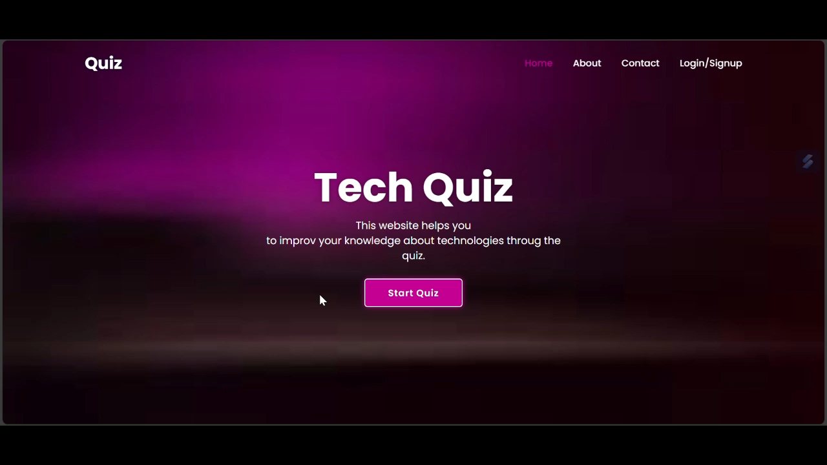

Slide 7
Technologies
HTML: Structure of the web pages.
CSS: Styling and layout (mention the two CSS files).
JavaScript: Functionality for user interactions (e.g., switching between login and signup).
NodeJS: For functional validation
External Libraries: Font Awesome for icons.

Slide 8
Future Scope
Personalization and User Experience
Gamification and Rewards
Mobile and Cross-Platform Experience
Niche and Specialized Content

Slide 9
Reference
Google form
GFG
YouTube
W3 School

Slide 10
Conclusion
Summary of the application’s purpose and features.
Future Enhancements: Potential features like user profiles, score tracking, and more questions.
Call to Action: Encourage users to try the quiz and provide feedback.

Slide 11


